Slide 1

Security using Facial Recognition
Under the Guidance of
Dr.Amjan Shaik, Professor & Associate HOD
Department of Computer Science & Engineering
B V Raju Institute of Technology, Narsapur
Presented by
B.Anirudh, 17211A0529
A.Vinod, 17211A0506
B.Rohith, 17211A0530
K.Venu, 18215A0503

Slide 2
Abstract
Abstract
Introduction
Existing System
Proposed System
Software/Hardware Requirements
References
Through this project we are going to create a facial recognition system which can detect faces of the intruders.
First, we will be storing the facial images of some trusted persons in a database.
Whenever a person shows up, the snapshots of his face is given as input to our application.

Slide 3
Abstract
Abstract
Introduction
Existing System
Proposed System
Software/Hardware Requirements
References
Our application compares the given person’s face with facial images in our database thereby authenticating that user.
If the user is a trusted person then our application will notify that person is a trusted one or else it says that he/she is not a trusted one.

Slide 4
Abstract
Abstract
Introduction
Existing System
Proposed System
Software/Hardware Requirements
References
OVERVIEW OF OUR APPLICATION:
TRUSTED
INPUT
IMAGE
APPLICATION
NOT TRUSTED PERSON
DB

Slide 5
Abstract
Introduction
Existing System
Proposed System
Software/Hardware Requirements
References
Introduction
In this project we will be using a deep neural network called FaceNet. This FaceNet returns a 128 dimensional vector face embeddings which is used to characterise an image.
We will be comparing the face embeddings of the given input image and of the already existing images in the database to check whether the two images represent same person or not. These face embeddings are generated by our FaceNet neural network.

Slide 6
Abstract
Introduction
Existing System
Proposed System
Software/Hardware Requirements
References
Existing System
FaceFirst:
It is a fully automated, user friendly, live-video surveillance facial recognition system. It generates a message to the owner whenever a known face is detected. It can even work in low resolution environments.
3D facial recognition:
This technique uses a 3D sensor to capture details of the face from all angles.

Slide 7
Abstract
Introduction
Existing System
Proposed System
Software/Hardware Requirements
References
Existing System
It captures all the necessary details like depth of the eye sockets, shape of nose, chin etc..The advantage of this system is that face can be identified from a variety of angles and also in different light conditions.
skin texture analysis:
This technique captures the visual details of the skin and then uses the unique lines, spots, patterns on the face to characterise a face.

Slide 8
Abstract
Introduction
Existing System
Proposed System
Software/Hardware Requirements
References
Proposed System
Our system uses a deep neural network known as FaceNet which returns a 128 dimensional vector embeddings which can characterise a face. This FaceNet is trained with the help triplet loss function which is used as an evaluation metric while training the examples.
Training:
We will try to minimise the triplet loss function while training with the training

Slide 9


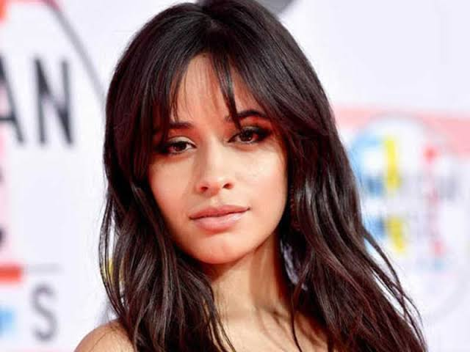
Abstract
Introduction
Existing System
Proposed System
Software/Hardware Requirements
References
Proposed System
examples. This forces our neural network to adjust its parameters in order to minimise the loss function.
Triplet loss function:
ANCHOR
POSITIVE
NEGATIVE

Slide 10
Abstract
Introduction
Existing System
Proposed System
Software/Hardware Requirements
References
Proposed System
So a triplet function will have 3 input images called anchor, positive and negative image which are all taken from our training dataset.
triplet_loss = |f(A)-f(P)|²-|f(A)-f(N)|²
where A=anchor image embeddings
P=positive image embeddings
N=negative image embeddings
f=neural network

Slide 11
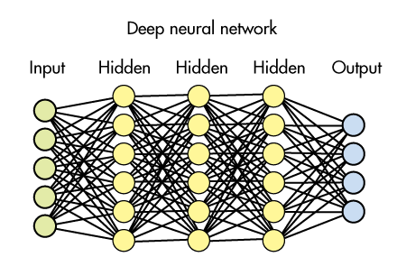
Abstract
Introduction
Existing System
Proposed System
Software/Hardware Requirements
References
Proposed System

Slide 12
Abstract
Introduction
Existing System
Proposed System
Software/Hardware Requirements
References
Proposed System
So if the 128 dimensional embedding vectors of two images are so similar then both the images represent same person otherwise they represent different persons.

Slide 13
Abstract
Introduction
Existing System
Proposed System
Software/Hardware Requirements
References
Software/Hardware Requirements
Software requirements:
Python environment
Tensorflow framework(keras)
Linux OS (preferable)
Hardware requirements:
8 GB RAM
1 GHZ processor
2 GB swap(virtual memory)
2/10

Slide 14
Abstract
Introduction
Existing System
Proposed System
Software/Hardware Requirements
References
References
For Journal Papers:
Florian schroff, Dmitry kalenichenko, James Philbin (2015). FaceNet: A unified embedding for face recognition and clustering
For Books:
[1]. Aurelien Geron: “Hands on machine learning using scikit-learn and tensorflow ”, pp. Total page number-568, Shroff publishers and distributors pvt. ltd., year of publication - 2017.

Slide 15
Q and A?
?

